Slide 1

Predicting Social-Emotional Composite Scores White Bear Lake Area Secondary Schools
Created and presented by:
Alyssa Weber
Notes:
This presentation is intended for the principal and administration team at White Bear Lake Area High School. My name is Alyssa Weber. It is my 8th year teaching mathematics in the district and I have also prepared this data science report.
Today I will present to you a model that can predict the social-emotional composite scores of our students with the hopes of earlier identification of students that need support.

Slide 2

Goal
“100% of students and staff will feel their social emotional needs are being supported”
Notes:
Set by the administration team for the 2022-2023 school year

Slide 3
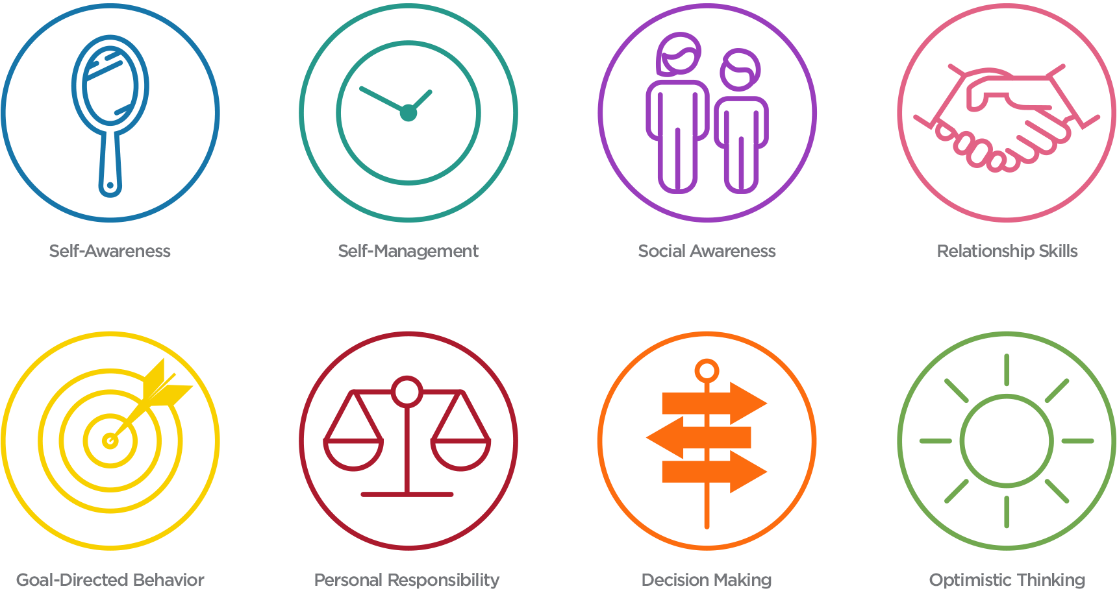
Dessa
Survey conducted in November and March
Notes:
In order to collect data on student mental health, the district has partnered with a company called Aperture Education. One of the tools available to us is the Dessa Survey which askes students multiple questions about their social skills including Self-Awareness, Self-Management, Social-Awareness, Relationship skills, Goal-Directed Behavior, Personal Responsibility, Decision Making, and Optimistic Thinking.
It compiles all of the self-reported answers into a Social Emotional Composite Score. These scores are then grouped into 3 categories… Needs Support, Typical, and Strength. The results provide invaluable data for our staff, but it presents two major problems. #1 the first round of surveys are not conducted until late November. At this point, we have already lost nearly 3 months of intervention time. # Two not every student takes the survey. Creating a model that can predict SEC scores before we gain access will help us identify at rish students sooner in the year so that we can begin interventions right away.

Slide 4

Proposal
Can we use data proactively to predict students in need of social-emotional support?
Notes:
This project would directly support the students at White Bear Lake High School. Administrators, support staff, and educators are presently using data reactively, rather than proactively, to target students in need of support mid-year.

Slide 5
Original Data Source
Prepared by Melinda Fierro
Director of teaching and learning
Member of the research, evaluation, and assessment team
Notes:
Data for this analysis has been put together by the director of teaching and learning who is also a part of the research, evaluation, and assessment team. The data includes grade level, gender, resolved race/ethnicity, zip code, home language, special education tags, 504 support tags, English language learner tags, total college credits taken and the latest date in which they were taken. It also includes the target variable of fall SEC (Social-Emotional Composite) scores

Slide 6
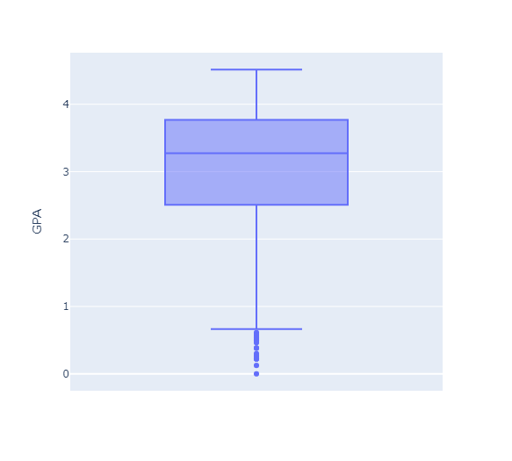
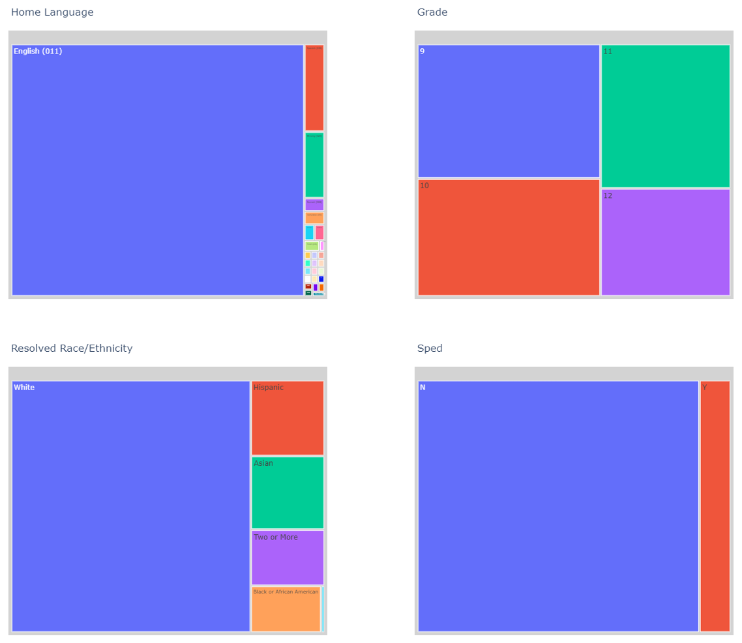
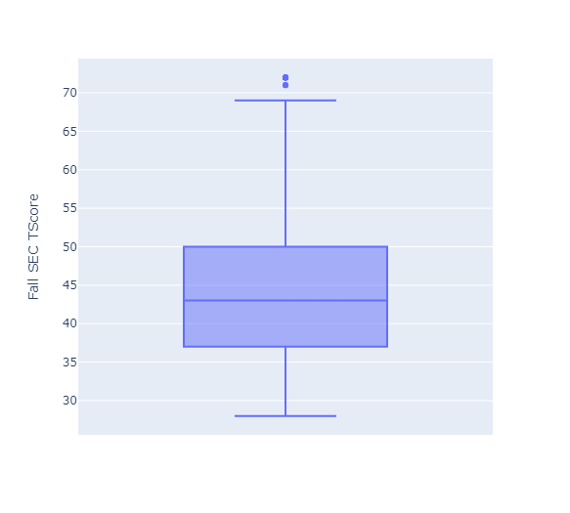
Breakdown of Data
Notes:
I took a minute to visualize some of the numerical and categorical features that were included in the original data set to make sure that there were no outliers present and that the sub categories had enough weight. In the upper left corner, I found that GPA scores ranged from 0-4.5 with many low outliers. I decided to keep this feature as the outliers are true reflections of student’s current progress even though they are low. Moving to the right you will see 4 categorical features. Grade, Race, and Sped tags all had enough data points in each of the sub categories to potentially be meaningful in our model. Home Language on the other hand consisted of 93% of students who spoke English at home. 23 other subgroups had counts of less than five, making this feature not reliable for a test/training split.
In the bottom left corner is the spread of composite scores. Notice there are two upper outliers. We should be a little bit wary that these students went through the survey quickly and self assessed themselves with very high ratings. However I let them be since we will ultimately be trying to predict students who need support based on their reflections of needing support.
Lastly, not shown on the slides, there were a few other features in which the data was mostly incomplete. Therefore, these features were deleted from the model.

Slide 7
Final Features
Categorical:
Grade
Gender
Resolved Race/Ethnicity
Home ZIP code
SPED
Target:
SEC Score – Categorical
Needs Support → 1
Typical or Strength → 0
Numerical:
GPA
Total College Credit Taken

Slide 8
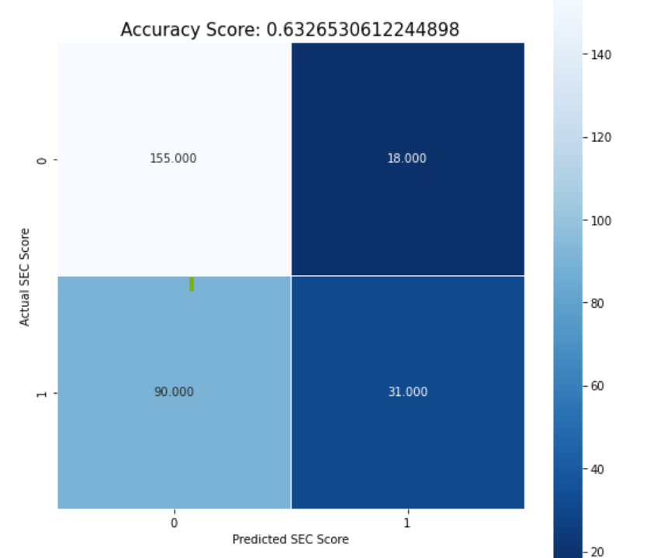
Logistic Model
Total Observations
294

Slide 9
Logistic Model
Accurate Prediction:
Does not need support
Total Observations
294
Accurate Prediction:
Needs support

Slide 10
Logistic Model
Inaccurate Prediction:
Predicted to need support, when in fact they do not
Total Observations
294
Inaccurate Prediction:
Predicted to not need support, when in fact they do

Slide 11
Recommendation
Deploy this model at the start of the 2023-2024 school year to select students that may be candidates for early social emotional intervention
Follow up after November Survey is deployed
Continue to monitor the model on new data in the upcoming years

Slide 12
References
Aperture Education. (2023, February 28). 9-12 sel. Social and Emotional Learning - Aperture Education. Retrieved March 26, 2023, from https://apertureed.com/9-12-student-portal/
Centers for Disease Control and Prevention. (2023, April 27). YRBSS Data Summary & Trends. Centers for Disease Control and Prevention. https://www.cdc.gov/healthyyouth/data/yrbs/yrbs_data_summary_and_trends.htm
Magson, N. R., Freeman, J. Y. A., Rapee, R. M., Richardson, C. E., Oar, E. L., & Fardouly, J. (2021, January). Risk and protective factors for prospective changes in adolescent mental health during the COVID-19 pandemic. Journal of youth and adolescence. https://www.ncbi.nlm.nih.gov/pmc/articles/PMC7590912/

